Slide 1
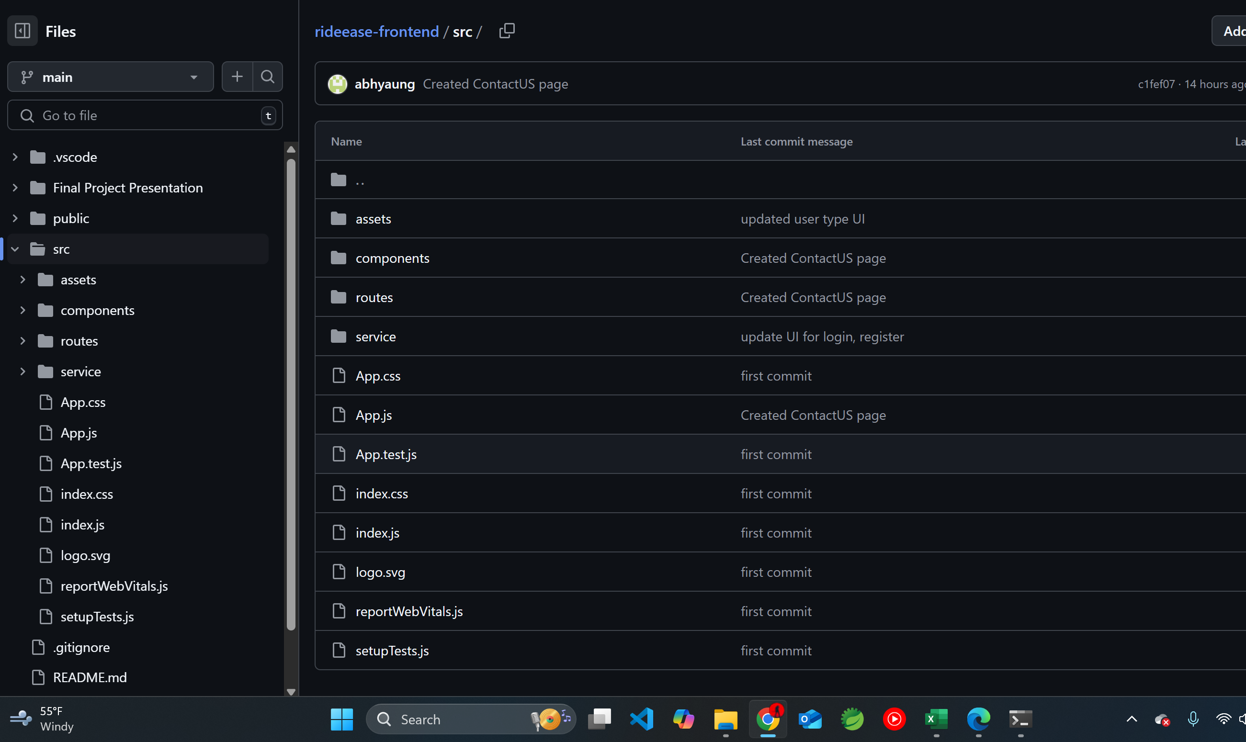
Project Structure - Frontend

Slide 2
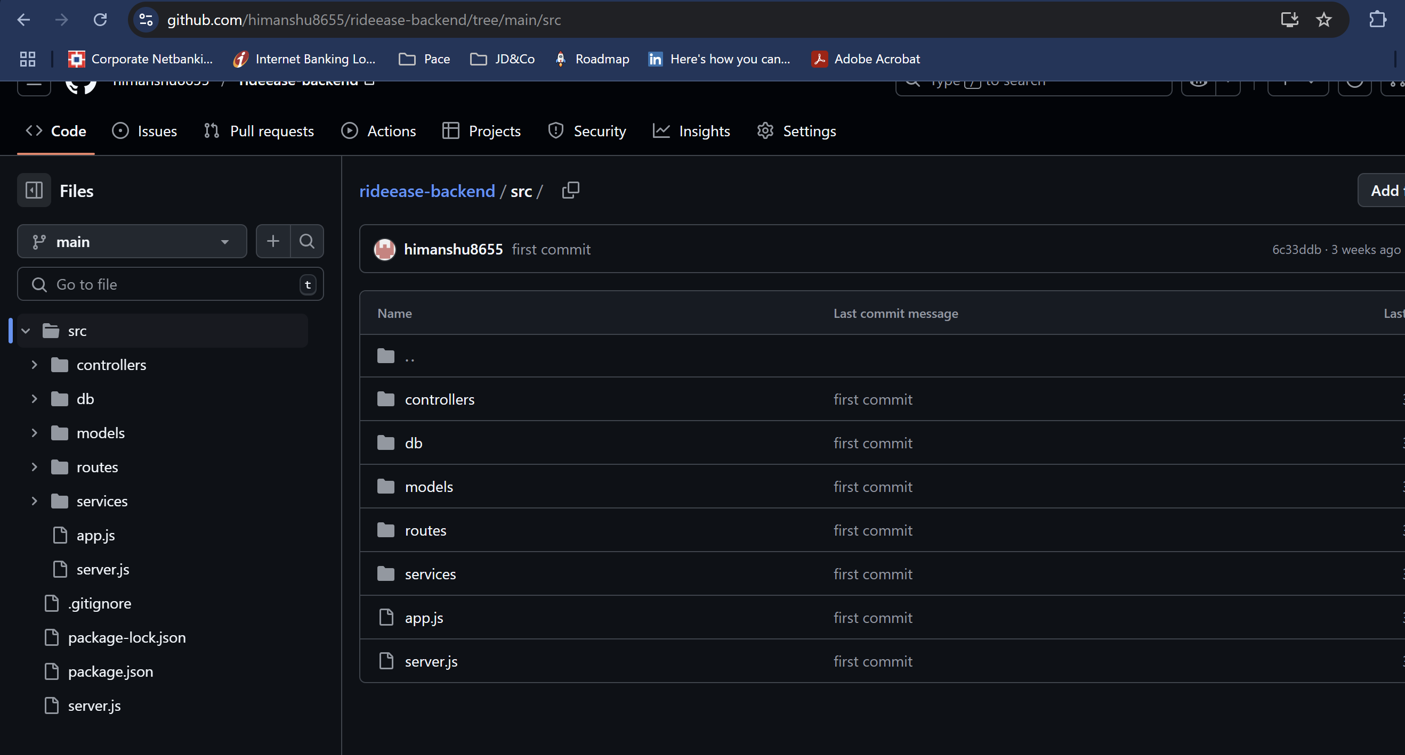
Project Structure - Backend

Slide 3
Thank You!

